Slide 1

John Lewis Invictus Academy
Notes:
Good Morning/Afternoon! Today we begin the process of planning our school’s budget for FY23. I know we are all here for the same reason and that is ensuring success for all (enter school name) students. This meeting is to provide an overview of the draft budget and for you to give feedback on the draft budget.

Slide 2
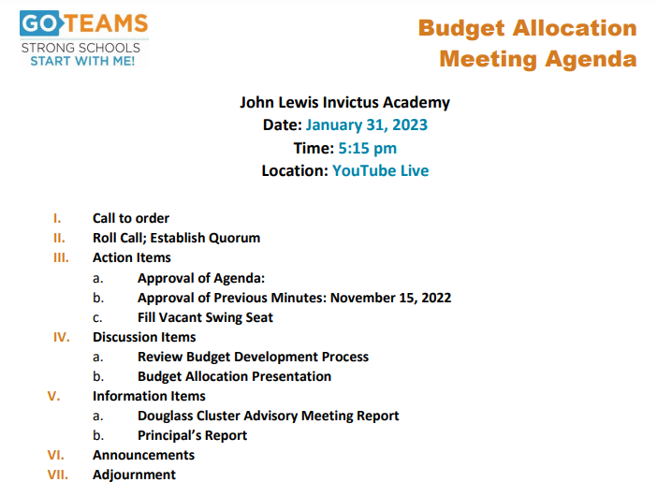

Slide 3
Norms
This is a meeting of the GO Team. Only members of the team may participate in the discussion. Any members of the public present are here to quietly observe.
We will follow the agenda as noticed to the public and stay on task.
We invite and welcome contributions of every member and listen to each other.
We will respect all ideas and assume good intentions.

Slide 4

GO Team Budget Development Process
OUR SCHOOL STRATEGIC PLAN…
is our roadmap.
It is our direction, our priorities, our vision, our present, our future.
Step 1: Data Review
Step 2: Strategic Plan Review
Step 3: Budget Parameters
(Strategic Priorities)
Step 4: Budget Choices
Notes:
Today I will provide an overview of the budget allocations for FY23. We will begin the work of funding the strategic priorities we agreed upon during our strategic review meeting.

Slide 5
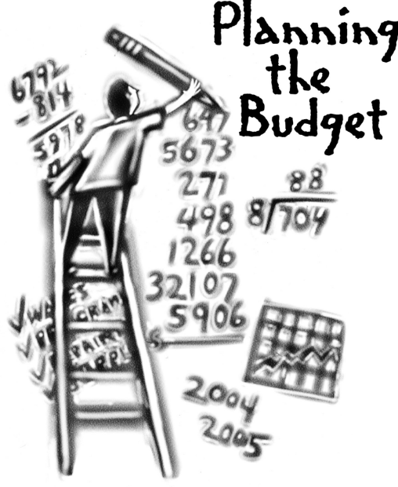
Overview of FY ‘24 GO Team Budget Process
Step 1 Review and Update Strategic Plan and Rank Strategic Priorities
By end of Fall Semester
Step 6 Principals: HR Staffing Conferences Begin
Late February – Early March
Step 3 GO Team Initial Budget Session: Allocation
January 31 (January 24 – early February)
Step 7 GO Team Final Budget Approval Meeting
March 14 (Budgets Approved by March 17)
Step 5
GO Team Feedback Session: Draft Budget Presented & Discussed February 13 (multiple meetings, if necessary, prior to Principal’s staffing conference)
Step 4 Principals: Associate Supt. Discussions and Review
February (supports needed, specific challenges, coaching)
Step 2 Principals: Workshop FY 24 Budget
January 24
GO Teams are encouraged to have ongoing conversations

Slide 6
Budget Allocation Meeting
What
The first GO Team meeting is when the principal will provide an overview of the budget allocation for GO Team members and the general public.
Why
This meeting provides an opportunity for the principal and GO Team to ensure alignment on the school’s key strategic priorities, gain a deeper understanding of the budget allocation, and provide input to drive the direction of the draft budget.
When
End of January- Early February

Slide 7
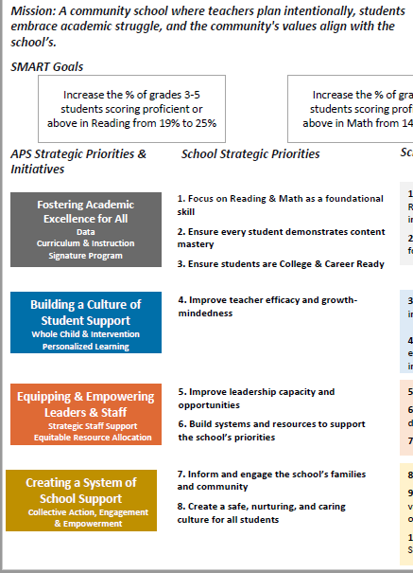
FY24 Budget Development Process
Principal’s Role
Design the budget and propose operational changes that can raise student achievement
Flesh out strategies, implement and manage them at the school level
Focus on the day-to-day operations
Serve as the expert on the school
Hire quality instructional and support personnel
The GO Team’s Role
Focus on the big picture (positions and resources, not people)
Ensure that the budget is aligned to the school’s mission and vision and that resources are allocated to support key strategic priorities

Slide 8
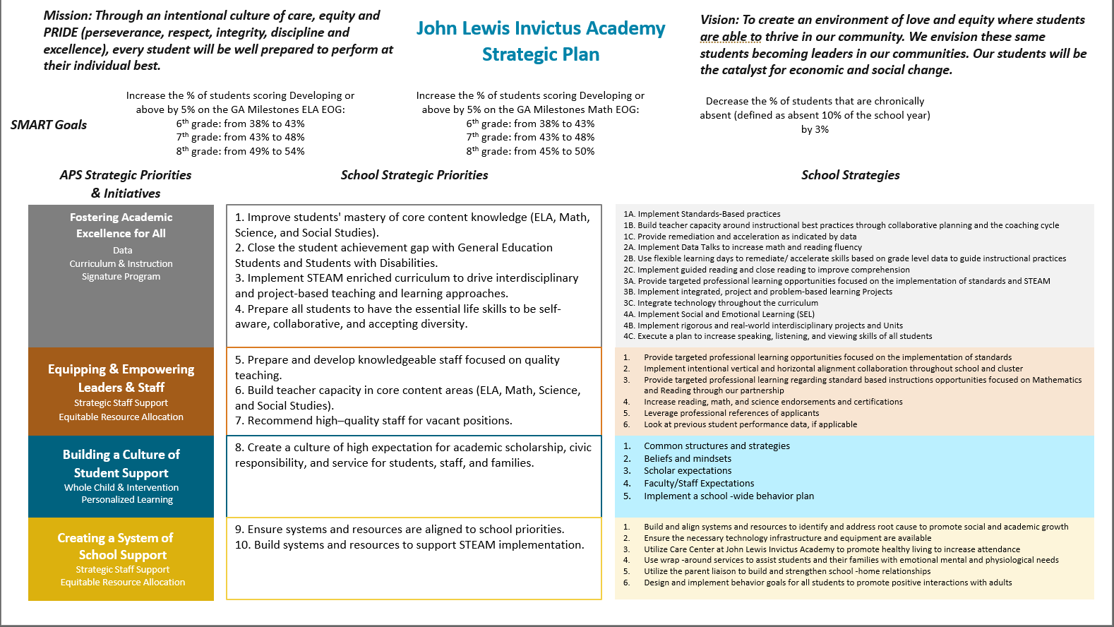

John Lewis Invictus Academy Strategic Plan
Notes:
You should have a copy of our updated strategic plan (please make copies to be distributed to team).

Slide 9
John Lewis Invictus Academy
Strategic Plan
Priority Ranking
Academic Programs
Talent Management
Culture
Systems and Resources
Higher
Lower

Slide 10
FY24 Budget Parameters
FY24 School Priorities | Rationale
Improve students’ mastery of core content knowledge (ELA, Math, Science and Social Studies) | A majority of scholars arrive at JLIA reading below grade level & with gaps in both their literacy and math proficiency.
Close the student achievement gap with General Education Students and Students with Disabilities | “Lagging achievement evidenced as early as fourth grade appears to be a powerful predictor of rates of high school and college graduation, as well as lifetime earnings” (McKinsey and Company, The Economic Impact of the Achievement Gap in America’s Schools, 2009).
Implement STEAM enriched curriculum to drive interdisciplinary and project-based teaching and learning approaches. | Atlanta is bustling with economic opportunities and a growing job market. We aspire for our students to have the type of educational experiences and success at JLIA that will position them not only to graduate high school, but to go onto college and emerge with the qualifications needed to land the types of high-paying jobs that will be waiting for them in their community.
Prepare all students to have the essential life skills to be self-aware, collaborative, and accepting diversity. | A majority of JLIA scholars are impacted by the social, emotional, behavioral, & health determinants of poverty that keep them from thriving academically in school.
Notes:
Review the priorities that the GO Team has developed and the rationale for these priorities. Feel free to copy this slide if you have more than 3 priorities to account for.

Slide 11
FY24 Budget Parameters
FY24 School Priorities | Rationale
Prepare and develop knowledgeable staff focused on quality teaching. | JLIA teachers need PD, coaching, and collaborative planning (PLC) support to equip them with the knowledge, skills, and mindsets necessary to ensure that every student has access to grade-appropriate assignments, strong instruction, deep engagement, and teachers with high expectations, every day, in every class—regardless of their race, ethnicity, or any other part of their identity.
Build teacher capacity in core content areas (ELA, Math, Science and Social Studies). | JLIA teachers need PD, coaching, and collaborative planning (PLC) support to equip them with the knowledge, skills, and mindsets necessary to ensure that every student has access to grade-appropriate assignments, strong instruction, deep engagement, and teachers with high expectations, every day, in every class—regardless of their race, ethnicity, or any other part of their identity.
Recommend high-quality staff for vacant positions. | JLIA teachers need PD, coaching, and collaborative planning (PLC) support to equip them with the knowledge, skills, and mindsets necessary to ensure that every student has access to grade-appropriate assignments, strong instruction, deep engagement, and teachers with high expectations, every day, in every class—regardless of their race, ethnicity, or any other part of their identity.
Notes:
Review the priorities that the GO Team has developed and the rationale for these priorities.

Slide 12
FY24 Budget Parameters
FY24 School Priorities | Rationale
Create a culture of high expectation for academic scholarship, civic responsibility and service for students, staff, and families. | In the classroom, we not only strive to close gaps, but to create a learning environment where students are positioned to thrive academically through daily exposure to rigorous and relevant content with practical, real-world applications.
Ensure systems and resources are aligned to school priorities. | In the classroom, we not only strive to close gaps, but to create a learning environment where students are positioned to thrive academically through daily exposure to rigorous and relevant content with practical, real-world applications.
Build systems and resources to support STEAM implementation. | In the classroom, we not only strive to close gaps, but to create a learning environment where students are positioned to thrive academically through daily exposure to rigorous and relevant content with practical, real-world applications.
Notes:
Review the priorities that the GO Team has developed and the rationale for these priorities.

Slide 13
Discussion of Budget Summary
(Step 4: Budget Choices)

Slide 14
Executive Summary
This budget represents an investment plan for our school’s students, employees, and the community.
The budget recommendations are tied directly to the school’s strategic vision and direction.
The proposed budget for the general operations of the school are reflected at $11,010,025
This investment plan for FY24 accommodates a student population that is projected to be 787 students, which is an increase of 12 students from FY23.
Notes:
Here’s a few highlights for our budget this year – read executive summary

Slide 15
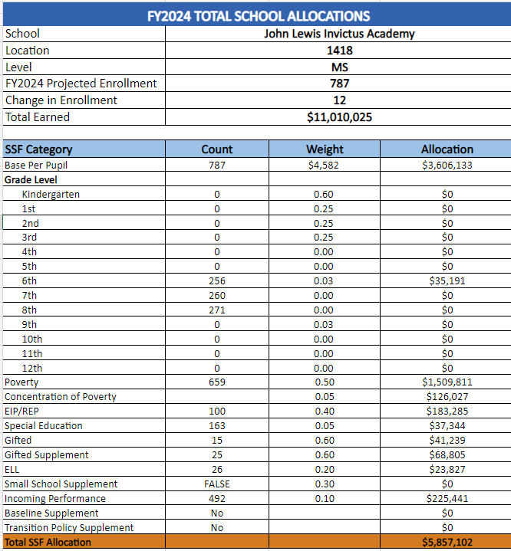
School Allocation
Notes:
For FY23, APS is continuing to increase equity within the District and the flexibility principals have in regards to our schools budgeted funds. The new Student Success Funding Model (SSF) allocates dollars to schools based on the number of enrolled students and receives a funding "weight" based on need. This year, student characteristics were weighted based on:
Grade Level –
K-12
Poverty – Weighted for all Direct Certification enrolled students.
Beginning Performance – Weighted Middle School and High School students entering with beginner’s performance on milestones.
ESOL – Weighted for all ESOL designated students in order to supplement due to ESOL staff being locked.
Special Education - Weighted for all Special Education students.
Gifted – Weighted and measured by number of students in the Gifted Program
Small School Supplement – Weighted for low enrollment schools
ES – 500
MS – 600
HS – 700
As you can see, our projected enrollment for FY23 is _______, we increased/decreased by __________ from last year.
We received the following weights for our student characteristics: (Below is just for the script, principals need to insert their school’s characteristics)
Grade Level
Poverty
Special Education
Gifted
Gifted Supplement
ELL
Small School Supplement

Slide 16
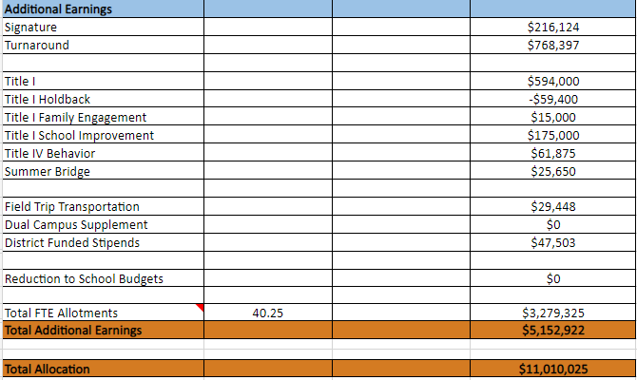
Notes:
Additionally, we received money for signature programming, turnaround, Title I and FTE Allotments.

Slide 17
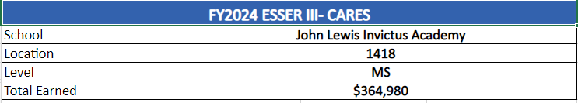
School FY24 CARES Allocation
In addition to a General Fund allocation, our school has been allocated CARES funding that must be used to support implementation of the school-based intervention block and other school-based needs as a result of the COVID-19 Pandemic.
Once the support needed to implement our school-based intervention block/course has been fulfilled, we can use the remaining CARES funds to address other school-based needs that are a result of the COVID-19 Pandemic.
Notes:
Reading Teacher, Saturday School, Afterschool Tutorials – additional opportunities for students to close gaps outside of the traditional school day.

Slide 18
CARES Allocations
Other allowable CARES expenditures include:
Technology Support: Software, assistive technology, online learning platforms, subscriptions.
Mental and Physical Health: Cover the costs of additional counseling, telehealth, therapeutic services, and wraparound services and supports (contracted hours, professional learning, programs)
Supplemental Learning: Cover costs of remediation, and/or enrichment opportunities during the school year for students (afterschool programs, additional pay for teachers and staff, transportation).
Professional Development: Cover costs of additional professional development for school leaders, teachers, and staff (trainings, extended professional development days, consultants, programs).
At-risk Student Populations: Cover costs of school specific activities, services, supports, programs, and/or targeted interventions directly addressing the needs of low-income students, SWD, racial & ethnic minorities, ELL, migrant & homeless students, and students in foster care.
Continuity of Core Staff and Services. Restore any potential LEA FY22 budget reductions due to decreased state and/or local revenue.

Slide 19
What’s Next?
January
  GO Team Budget Allocation Meeting (this meeting – January 31, 2023)
February
  One-on-one Associate Superintendent discussions
  Cluster Planning Session (positions sharing, cluster alignment, etc.)
  Program Manager discussions and approvals
  GO Team Feedback Meeting(s) before principal’s staffing conference
  (currently scheduled for February 13, 2023)
  HR Staffing Conferences (Late February)
March
  Final GO Team Approval Meeting (AFTER your school’s Staffing Conference and BEFORE Friday, March 17th) (currently scheduled for March 14, 2023)
Notes:
In February, we will meet again to discuss how the school’s budget has been allocated to support the programmatic needs and FY23 key strategic priorities.
If think we need to continue our budget conversations, we will schedule additional meetings. My goal is to make sure your voices are reflected in our school’s budget.
I will also be meeting with my Associate Superintendent, program managers and other key leaders to go over our budget and to make sure the school is meeting the standards of service and appropriately staffing.
During the week of Feb. 24th -March 2nd , HR Staffing Conferences will be held. At this meeting, I will present my plan for staff utilization, resource distribution and plan for staffing implications.
We will need to approve the budget at the ________ meeting.

Slide 20
Announcements
Don’t forget to complete your budget training.
All GO Team members must complete their training prior to the final action on the school’s budget.
The video only takes 5 minutes and is located in ELiS.
Notes:
In February, we will meet again to discuss how the school’s budget has been allocated to support the programmatic needs and FY23 key strategic priorities.
If think we need to continue our budget conversations, we will schedule additional meetings. My goal is to make sure your voices are reflected in our school’s budget.
I will also be meeting with my Associate Superintendent, program managers and other key leaders to go over our budget and to make sure the school is meeting the standards of service and appropriately staffing.
During the week of Feb. 24th -March 2nd , HR Staffing Conferences will be held. At this meeting, I will present my plan for staff utilization, resource distribution and plan for staffing implications.
We will need to approve the budget at the ________ meeting.

Slide 21

Questions?
Thank you for your time and attention.
Notes:
IF YOU FEEL YOUR TEAM IS READY TO APPROVE THE DRAFT BUDGET, PLEASE DO SO. PLEASE REMIND THEM THAT YOU MAY NEED TO MEET WITH THEM AGAIN, IF THERE ARE CHANGES FROM YOUR MEETINGS WITH DISTRICT LEADERSHIP. LET THEM KNOW YOU WILL KEEP THEM INFORMED!!

